Slide 1
APOLOGETICS
IN ONE LESSON
almost
Ai1L.net
Lesson 16
With the Gospel, I See the World as It Is

Slide 2
Key Takeaways (review)
1
Circumstantial evidence is valid; and has the advantage of coming from different sources
2
The Gospels include many “undesigned coincidences” which are difficult to explain if they were made up
3
Differences between the Gospel accounts give support to them including independent accounts

Slide 3
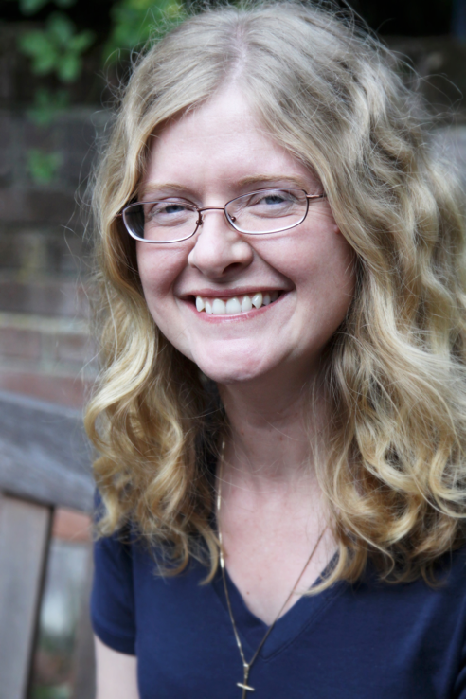
“﻿When I encountered arguments and evidence for Christianity, my reason was finally able to align with my imagination, which, like a compass needle, had tremulously pointed toward true north for many years.”
HOLLY ORDWAY Not God's Type

Slide 4
Values & Needs
“I want Christianity to be true”
Facts “I believe Christianity is true”
Christianity can explain values
(why racism is wrong, why truth matters, etc.)
Undesigned coincidences
Eyewitness sources
Christianity can fill our deepest needs (hope, love, forgiveness, justice)
Christianity shouldn’t exist (if not for Jesus’ resurrection)
Ancient Jewish teaching practices
Prophecy (Isaiah 53)

Slide 5
IDEA IN BRIEF
What?
The Gospel explains the way that the world is (and explains us)
Why?
To show that the Gospel is able to answer questions that a strictly materialistic worldview cannot
How?
By considering ways in which the Gospel story resonates with the human condition

Slide 6
List out some ways in which David Wood lived out his Atheism
1

Slide 7
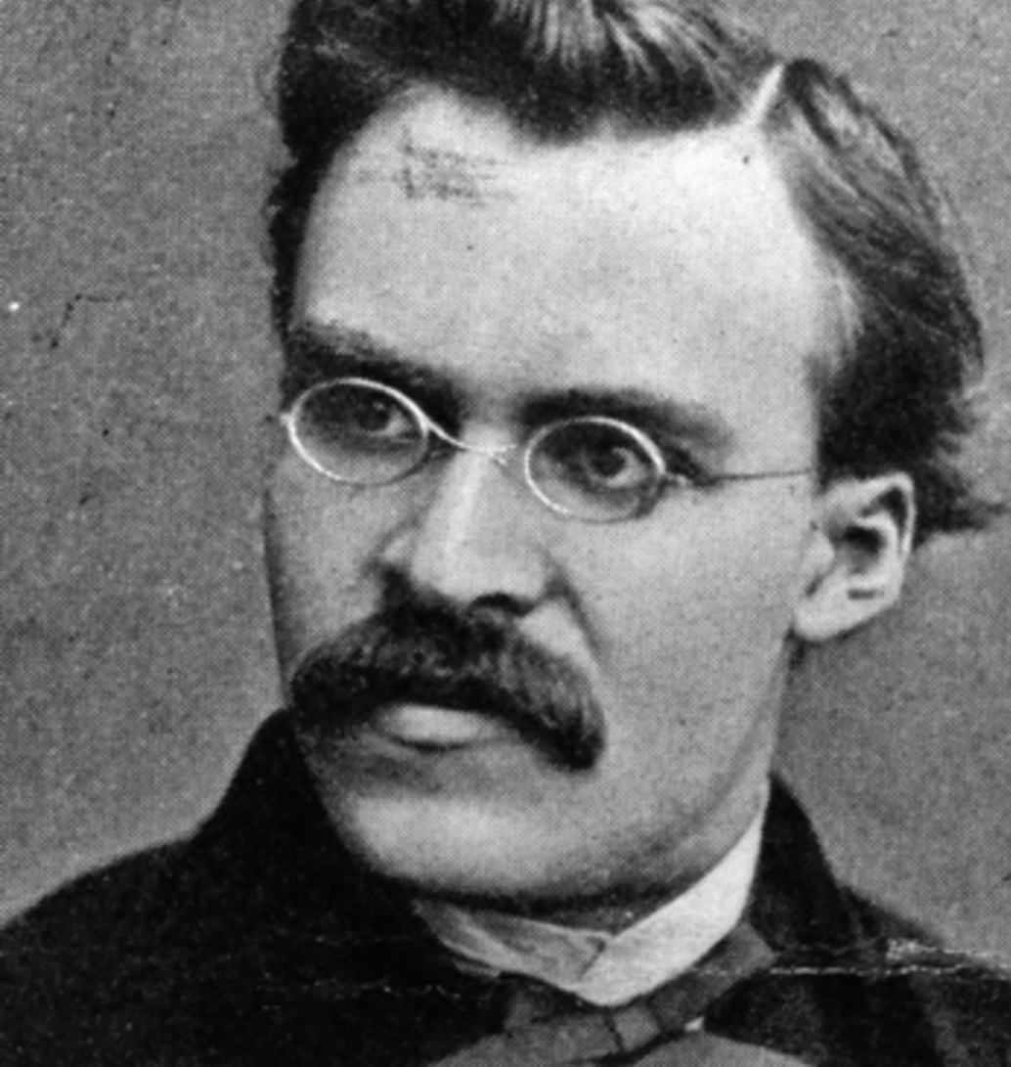
“God is dead. God remains dead. And we have killed him. How shall we comfort ourselves, the murderers of all murderers? What was holiest and mightiest of all that the world has yet owned has bled to death under our knives: who will wipe this blood off us? What water is there for us to clean ourselves?”
FRIEDRICH NIETZSCHE Thus Spoke Zarathustra

Slide 8
“When one gives up the Christian faith, one pulls the right to Christian morality out from under one's feet. This morality is by no means self-evident… Christianity is a system, a whole view of things thought out together. By breaking one main concept out of it, the faith in God, one breaks the whole.”
FRIEDRICH NIETZSCHE Twilight of the Idols

Slide 9
“What I relate is the history of the next two centuries. I describe what is coming, what can no longer come differently: the advent of nihilism... For some time now our whole European culture has been moving as toward a catastrophe.”
FRIEDRICH NIETZSCHE The Will to Power

Slide 10
“I believe in Christianity … because by it I see everything else.”
2

Slide 11
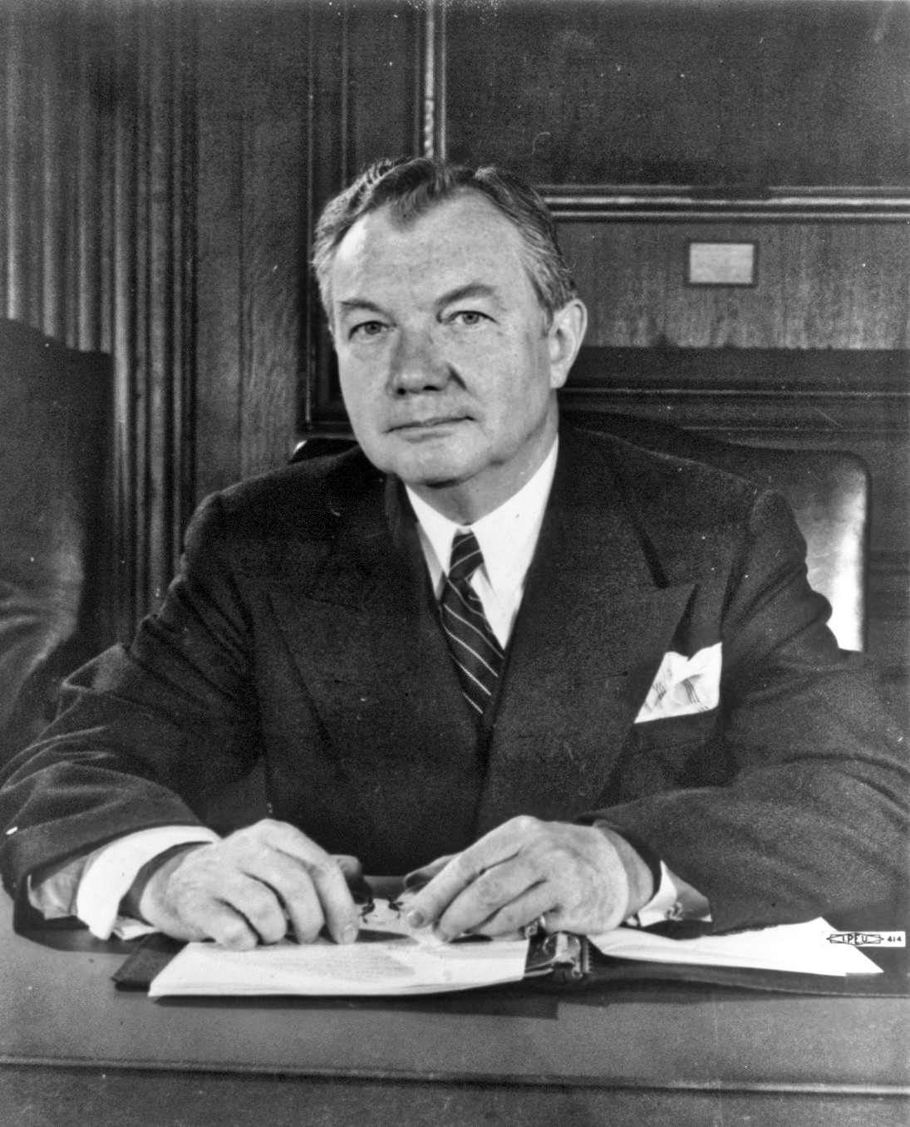
“there is in the tradition and experience which we include under the name of ‘the law’, a wisdom higher than that of any legislature or its statutes and more sure than that of any court or its decisions.”
JUSTICE ROBERT H. JACKSON The Law Above Nations

Slide 12
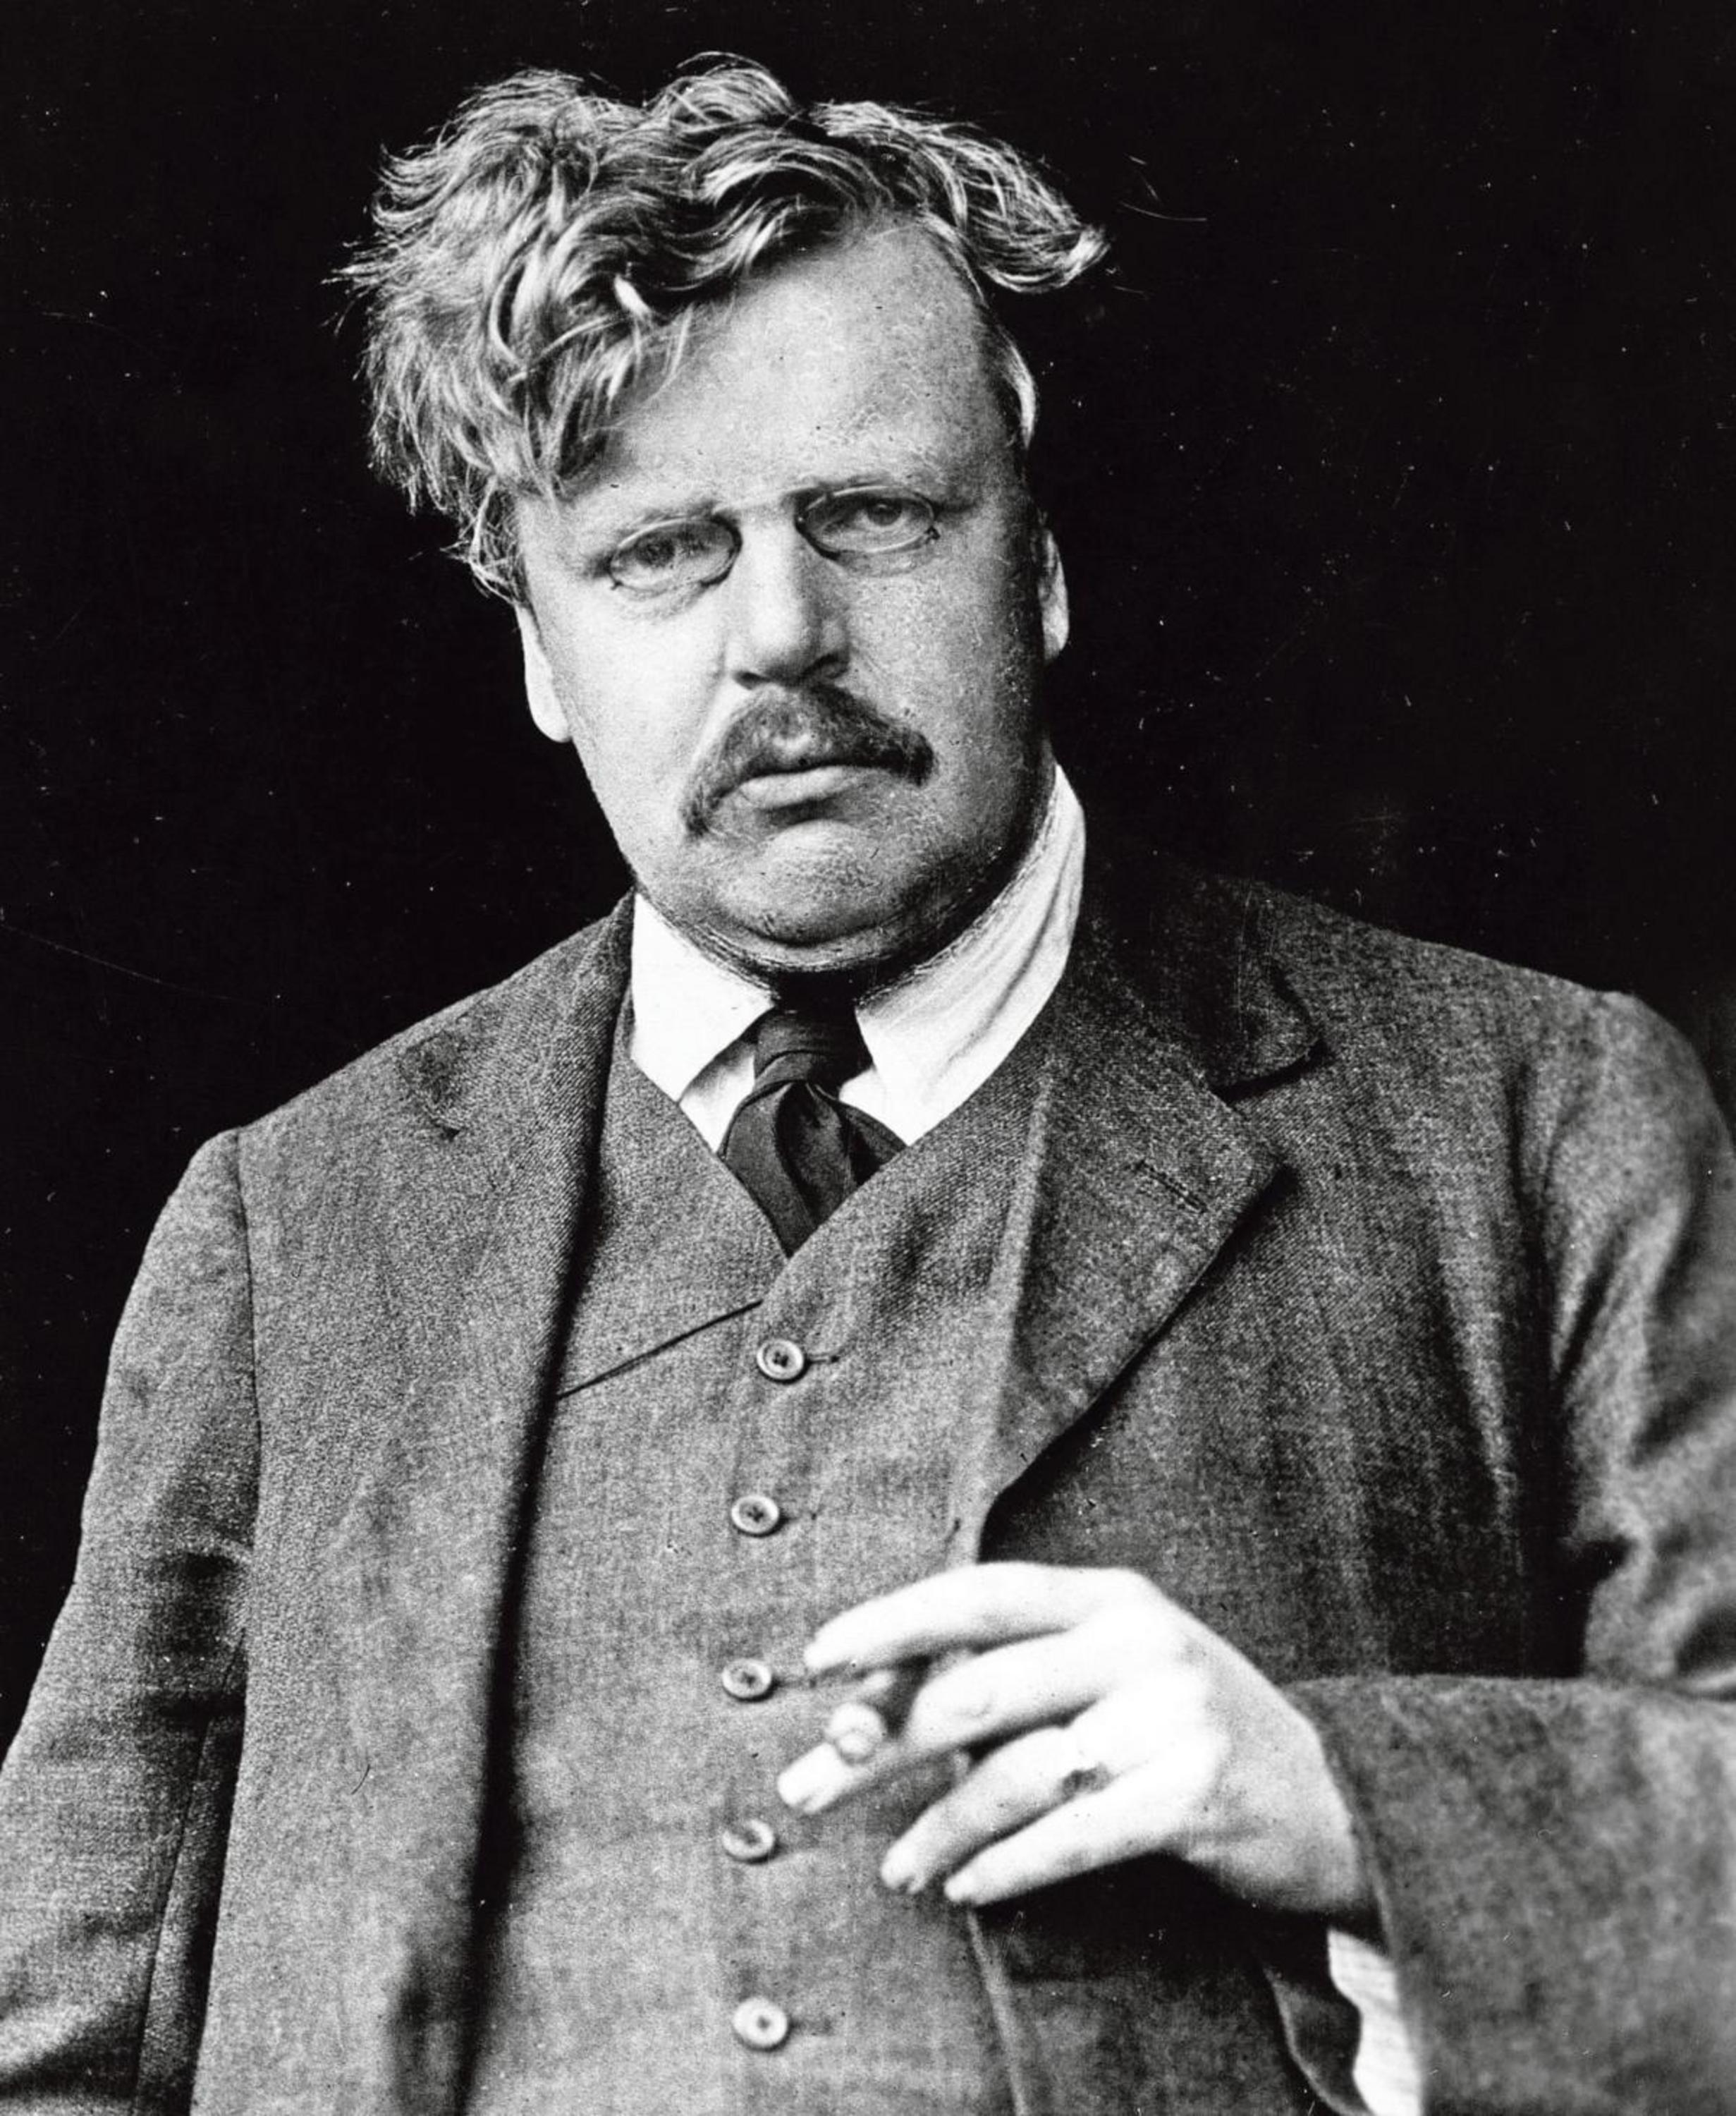
“Dear Sir, I am. Yours, G.K. Chesterton.”
G.K. CHESTERTON Essay in response to “what is wrong with the world?”

Slide 13
“Is there progress in the world?
He might say ‘no’ and make fun of the sillier versions of it, but he acted ‘yes’ and based his life of hope on it.”
KATHARINE TAIT (DAUGHTER OF BERTRAND RUSSELL) My Father, Bertrand Russell (page 184)

Slide 14
“It is just as absurd to ask strength not to express itself as strength, not to be a desire to overthrow, crush, become master, [not] to be a thirst for enemies, resistance and triumphs, as it is to ask weakness to express itself as strength.”
FRIEDRICH NIETZSCHE On the Genealogy of Morality

Slide 15
“We were made for another world”
3

Slide 16
“﻿The central neurosis of our time is emptiness”
CARL GUSTAV JUNG

Slide 17
“﻿if they felt life was meaningless, why didn’t they just kill themselves?
My teacher replied, ‘A lot of them did.’”
HOLLY ORDWAY Not God's Type
Notes:
My teacher replied, ‘A lot of them did.’”

Slide 18
“Let them know that death is not the period that ends this great sentence of life but a comma that punctuates it to more lofty significance.”
MARTIN LUTHER KING A Knock at Midnight

Slide 19
“No decent person wants to live in a society which works according to Darwinian laws.... A Darwinian society would be a Fascist state ”
RICHARD DAWKINS Die Presse, July 30, 2005, p. viii.

Slide 20
“Human history… [is] the long terrible story of man trying to find something other than God which will make him happy.”
4

Slide 21
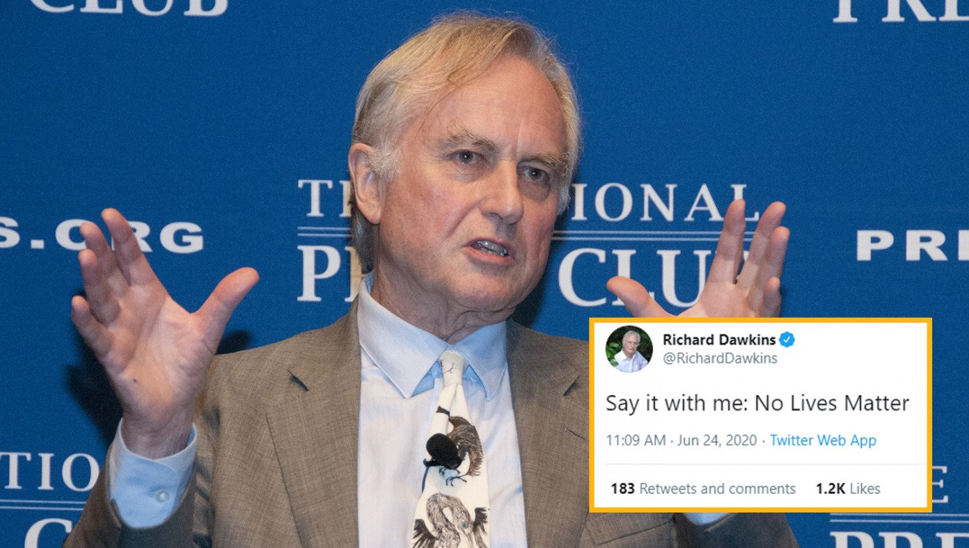
Atheists Launch No Lives Matter Movement
BABYLON BEE, JULY 7TH, 2020

Slide 22
Key Takeaways
1
Showing people that they should want the Gospel to be true is important
2
The Gospel helps us to make sense of this world
3
We have desires that cannot be filled with things in this world

